Slide 1
Data 100
Discussion #1
January 25th, 2022
Sign in here: https://tinyurl.com/data100-sp23-dis
Password: rahul

Slide 2
Intro + Housekeeping

Slide 3
Getting in touch
Make an EdStem post! This is the best way to get a response ASAP!
Come to my office hours
Thursday 1 - 2 PM @ Warren 101B
Important Note: Please, please, please don’t ever hesitate to reach out if you have any questions or concerns!
No question is too small or insignificant. I am here for you, I want to help you have a great semester, and you are always worth my time.

Slide 4
Linear Algebra (P)review

Slide 5
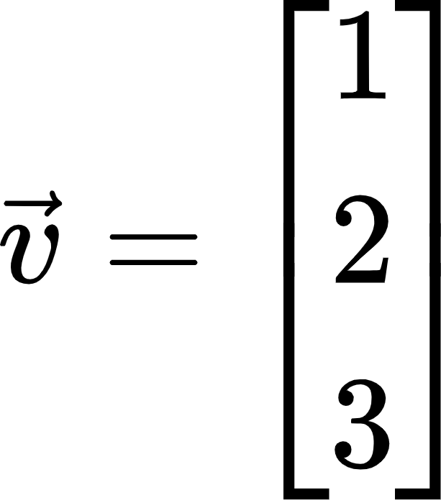
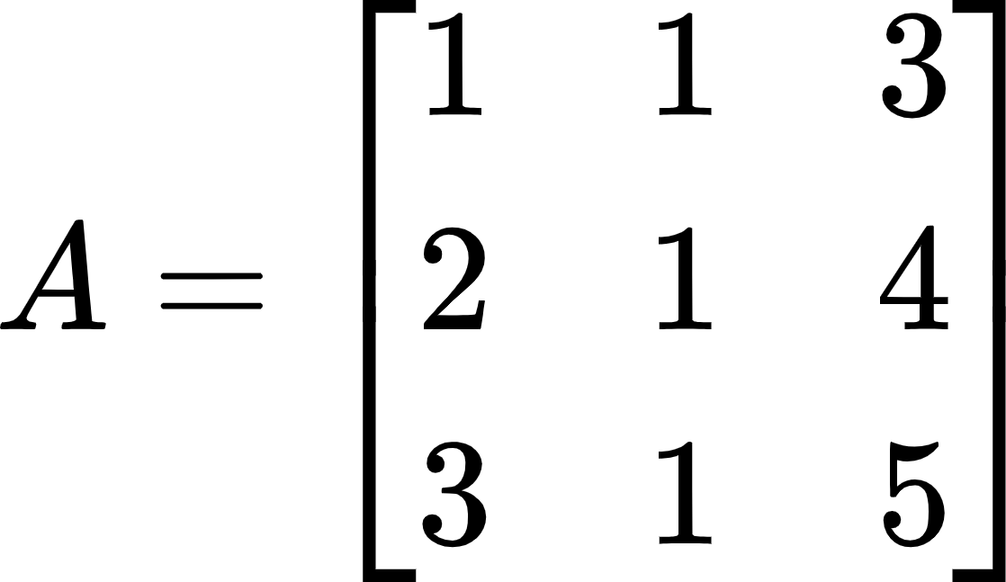
Vectors + Matrices
This is a vector:
Give a weight of 1 to the x direction,
a weight of 2 to the y direction, and
a weight of 3 to the z direction
This is a matrix:
We can think of this as a collection of three vectors

Slide 6
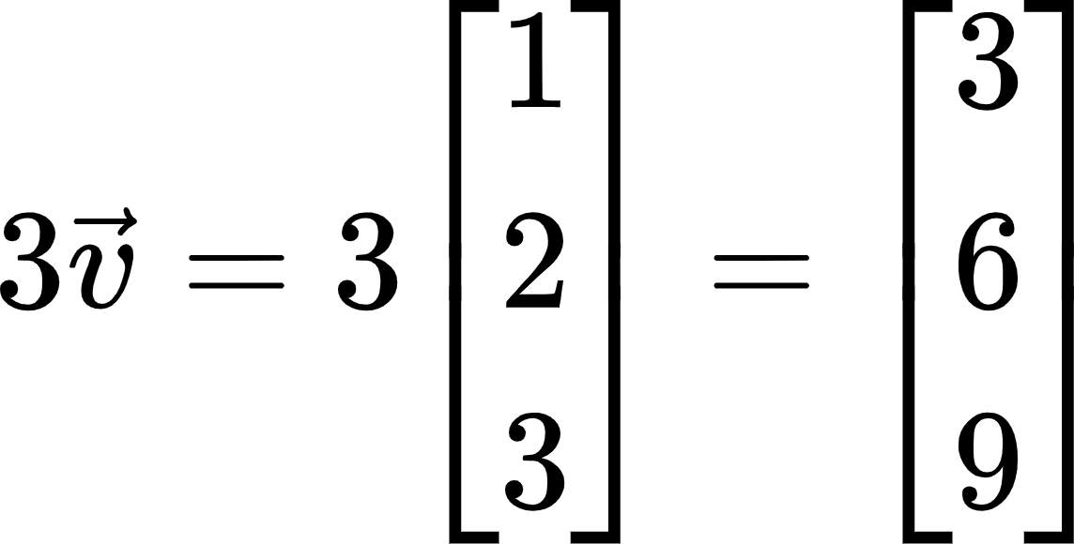
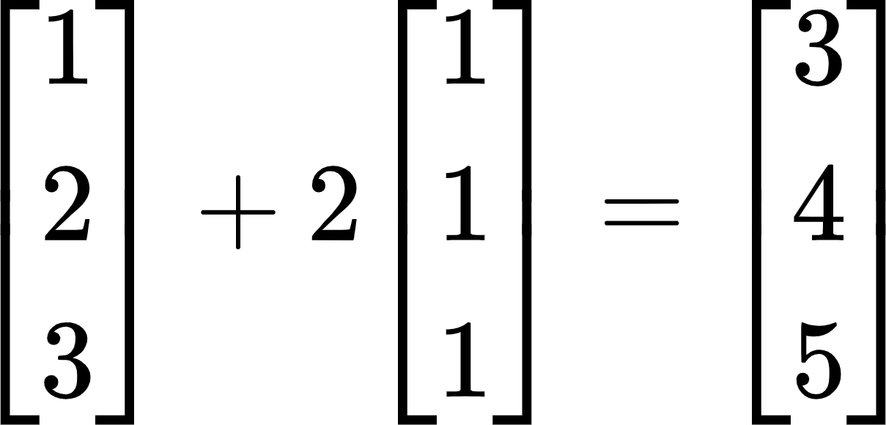
Vector Operations
We can scale vectors by scalar values:
This stretches the original vector by a factor of 3 in each direction
We can also add vectors to one another:

Slide 7
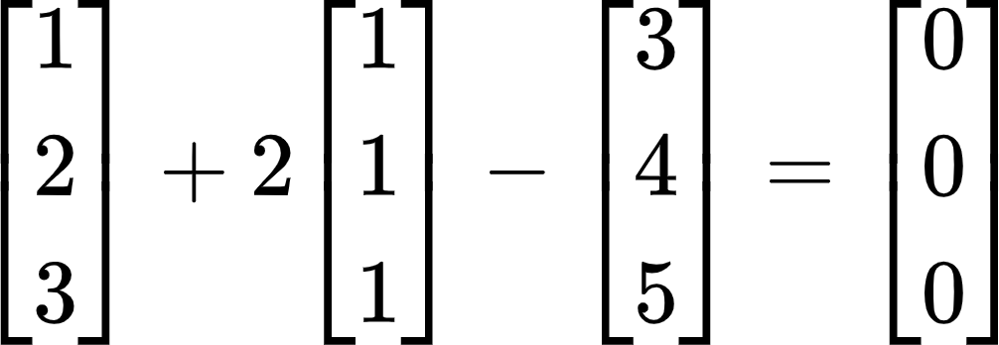

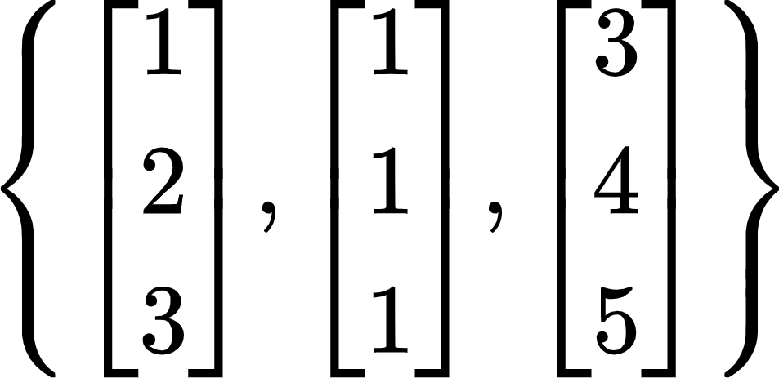
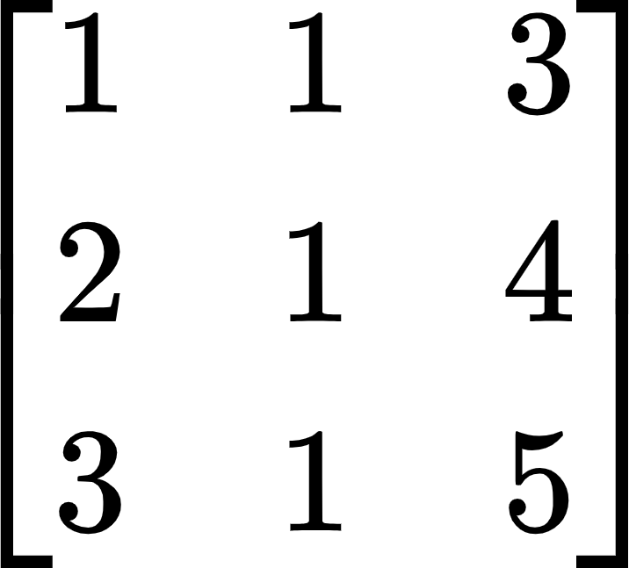
Linear Independence
We say that a set of vectors is linearly independent if there is no way of adding and scaling the vectors to produce the zero vector:
Because we can combine the vectors to produce , we say that is linearly dependent
The column rank of a matrix is the maximum number of columns we can take from the matrix to still have a linearly-independent set:
If we only had two of the columns in this matrix, we wouldn’t be able to create
We say this matrix has rank 2

Slide 8
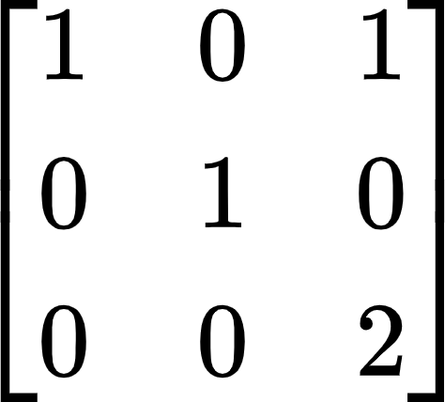








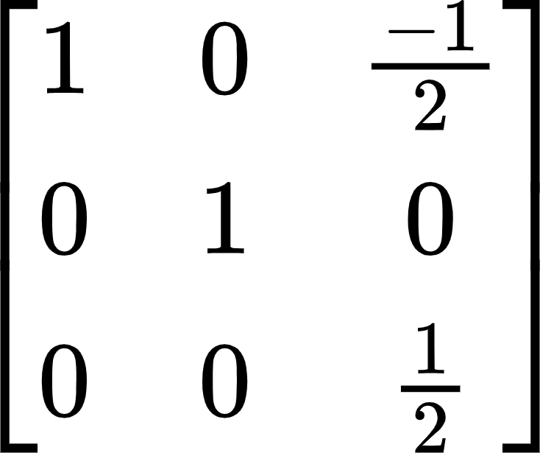
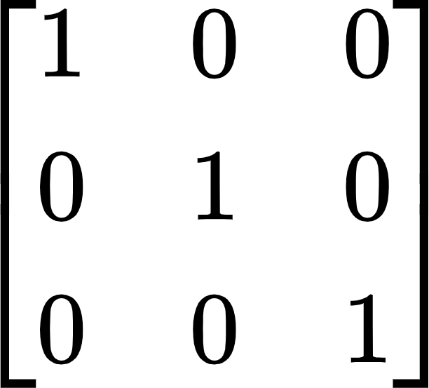
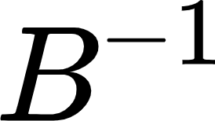

Matrix Multiplication + Inverses
We can multiply two matrices (or a matrix and a vector) to produce a new matrix or vector:
Entry is found by taking the dot product of row 1 in and column 1 in
If we multiply a matrix by its inverse, we output the identity matrix:

Slide 9
Discussion Worksheet

Slide 10
Looking Ahead

Slide 11
Advice for Data 100
Look for connections between topics
This class covers a lot of content - think about how everything fits into the data science life cycle
Keep a formula sheet along the way
You will be meeting many new math formulas this semester - it can be helpful to have a running list for your own reference
Brush up on calculus and linear algebra if you’re feeling shaky
Things to know: derivatives, vector spaces, matrix operations, linear combinations. 3Blue1Brown has great linalg recap videos
Reach out via Ed or OH if you’d like pointers on specific topics
Take advantage of all of the resources available to you
Ed, OH, Discussion, Lab, TAs (me and all the others!), other students, docs

Slide 12
The many links of Data 100
Course website: https://ds100.org/sp22/
Resources for our discussion sections: http://bit.ly/3HFJFNf
Calendar (OH times, discussion/lab): https://ds100.org/sp22/calendar/
Ed: https://edstem.org/us/courses/15436/discussion/
Gradescope: https://www.gradescope.com/courses/353100
Office Hours queue (used for both online and in-person OH): https://oh.ds100.org/
Pandas, SQL, Regex reference (not relevant to you quite yet, but will be useful soon): https://ds100.org/sp22/resources/assets/exams/sp20/sp20_checkpoint_reference_sheet.pdf

Slide 13
Remember:
Course staff wants you to succeed! You should never hesitate to ask questions, seek out advice, or clarify new ideas.

